Slide 1
Average Atomic Mass

Slide 2
Background
The Carbon-12 atom is used as the reference for all other atomic masses.
One C-12 atom has a mass of 12 atomic mass units (12 amu or 12u)
1u = 1/12 of the mass of a C-12 atom

Slide 3
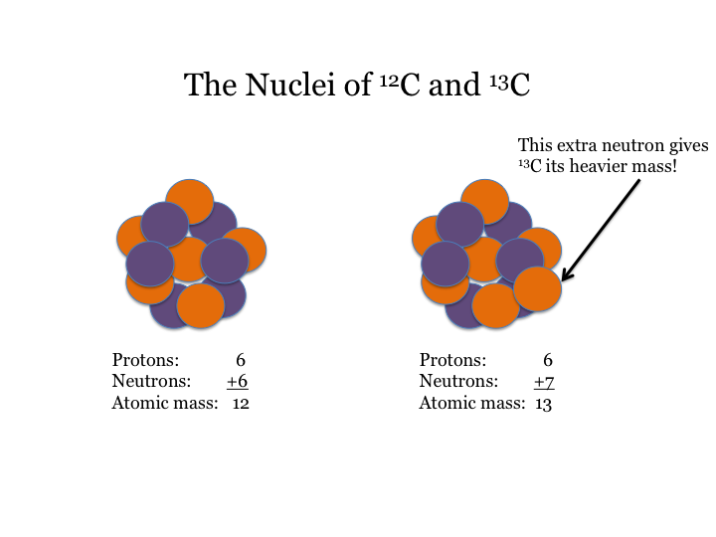

Slide 4
Average Atomic Mass
The weighted average of the atomic masses of the naturally occurring isotopes of an element
Most elements occur naturally as mixtures of isotopes

Slide 5
Average Atomic Mass
Dependent upon both mass and the relative abundance of each of the elements isotopes
m_{average} = (m_{isotope 1})(% abundance)+(m_{isotope2})(% abundance)
Repeat to add up the (m x %) for ALL isotopes

Slide 6
Example
Naturally occurring copper exists with the following abundances:
Let’s use our whiteboards to try! Click for Answer
m = (62.93 amu)(0.6917)+ (64.93 amu)(0.3083)= 63.55 amu
Isotope | Actual Mass (amu) | % Abundance
Cu-63 | 62.93 | 69.17%
Cu-65 | 64.93 | 30.83%

Slide 7
Problem 1
3 Isotopes of Argon occur in nature
Whiteboards at the ready!!
0.337% as Ar-36, 35.97 amu
0.063% Ar-38, 37.96 amu
99.6% Ar-40, 39.96 amu
Calculate the Average Atomic Mass

Slide 8
Answer Check
m = (35.97 amu)(0.00337) + (37.96 amu)(0.00063) + (39.96 amu)x(0.996)= 39.95 amu

Slide 9
Problem 2
2 Naturally occurring Isotopes of Boron occur with the following abundances:
In your notes, check with your neighbour:
80.20% B-11, 11.01 amu
19.80% B-10, 10.81 amu
What is the Average Atomic Mass

Slide 10
Answer Check
(11.01 amu)(0.8020) + (10.81 amu)(0.1980) = 10.97 amu

